Slide 1
Portfolio Day
& Bright Futures Exhibit
Parker Arts PACE Center 20000 Pikes Peak Ave., Parker

Slide 2
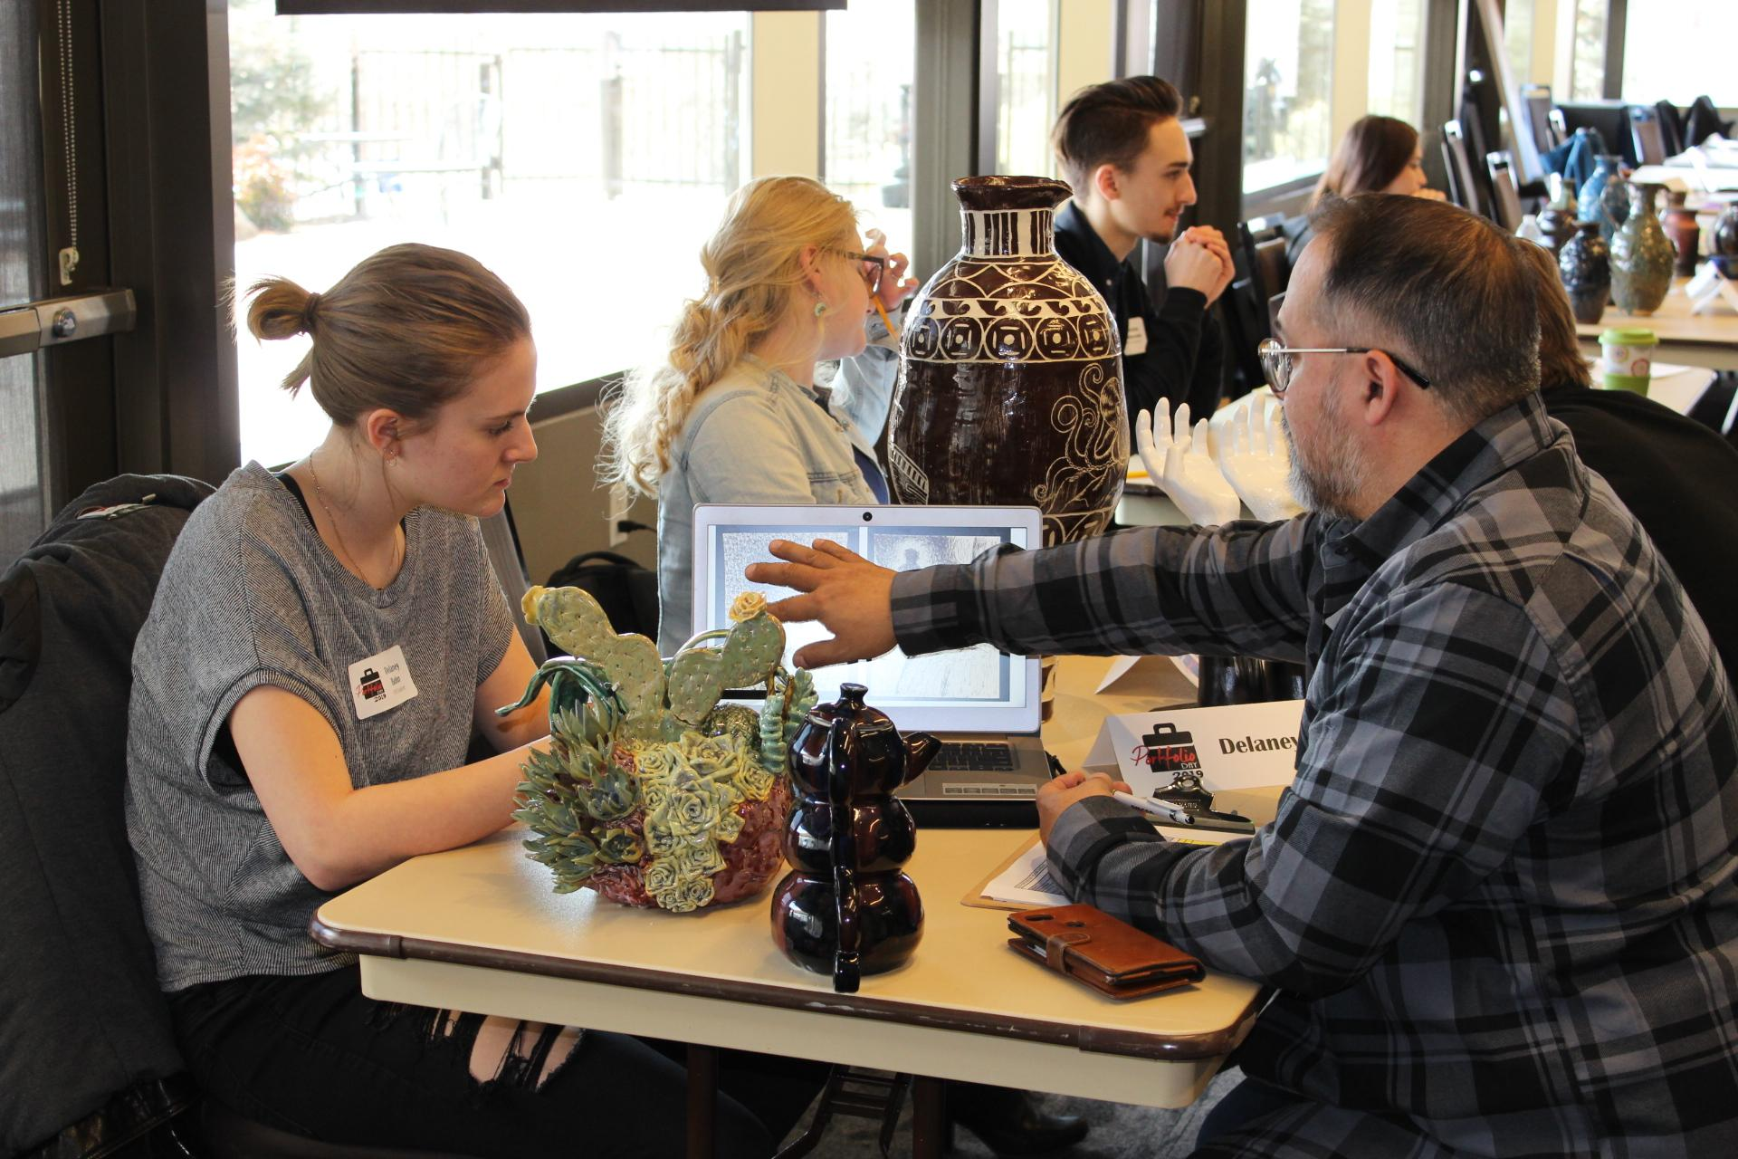
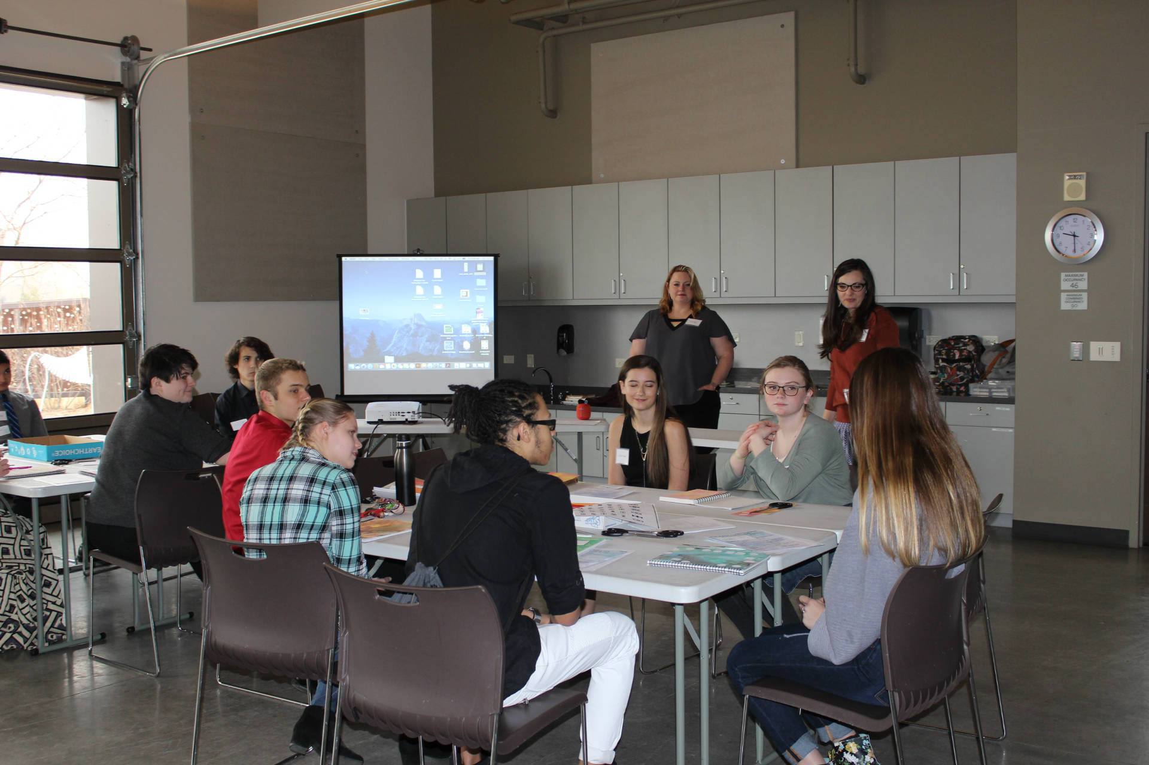
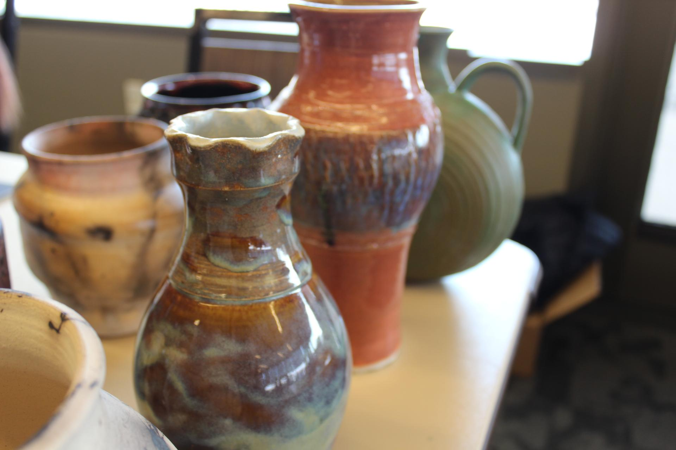
About portfolio day
Professional development opportunity
Professional review and critique
Monetary awards
Student art exhibition at PACE Center
Notes:
Portfolio Day is a program professional development opportunity for high school students aspiring to major in arts or have a career in the arts. The goal is to help students understand the purpose behind a good portfolio, how to use it to their advantage, and how to identify their best works for a portfolio. Equally, the feedback students receive as part of their portfolio review will help them identify their strength and talents and what to improve to be taken seriously as an artist.
In the past we have had reviewers from colleges that include: Arapahoe Community College, Art Students’ League of Denver, Rocky Mountain College of Art and Design (RMCAD), Metro State University of Denver, Colorado University of Denver, Mesa State, University of Northern Colorado, and Red Rocks Community College.
Many of these colleges will be onsite with recruiter tables to share information about their art programs.
Some of these colleges will offer scholarships to their art programs or summer art camps, while the Parker Artist Guild will select winners in each category to award monetary prizes.
Awards will be presented to students during the Bright Futures reception.

Slide 3
Benefits of portfolio day
Professional Experience
Exhibit in an art gallery
Admissions
Counseling
Scholarships
Monetary Prizes $$
Resume builder
FEEDBACK
from art professionals!
Get out of school for the day :)
Career development
Notes:
Benefits to participate in Portfolio Day include: gaining experience in building a professional portfolio to use for college admissions or career development; exhibit in a professional gallery at the PACE Center in Parker; have the opportunity to speak with professionals in the industry; and be awarded monetary prizes and scholarships.

Slide 4
What is a portfolio?

Slide 5
A portfolio is…
10 – 15 pieces of finished artwork
Examples of sketches or working documents that show your creative process
Examples that show a range of different skills within your area of specialization
Examples of strong observational drawing skills (whatever your medium)
A range of subject matter
Well-balanced compositions
Original art that demonstrates creativity and originality
Logically ordered examples that show progression or some sort of “journey”
An artist's portfolio is an edited collection of an artist's best artwork intended to showcase their style or method of work. A portfolio is used by artists to share with colleges or employers their talent by showing different samples of current work.
Notes:
An art portfolio isn't a collection of everything you've ever made; rather, it's a carefully curated sample of your best work.
Plan to show a variety of technical skills and creative skills.
As artists, we encourage students to draw something first from observation; these sketches can be included. You may even include a sketch book or finished work from your sketch book if they are an accurate representation of your work.
It can be an entire spectrum of your work, but just make sure it is your strongest. Or your portfolio can be a body of work - if you have 10 pieces of the same theme, you’ll want to break them up and only include 3 of them to represent a theme. The rest of your portfolio should represent your scope of work.
Your artwork should tell your personal concepts, ideation, experiences, convictions, or how your imagination sees the world, or even a retelling of a familiar story. This is your chance to share your wisdom with the world. Explore thoughts that made you happy or want to express yourself to find your voice – this may be doodles or work you do when no one is looking, because it will most likely be the work you will do for the rest of your life.
In piecing together your portfolio, you should order artwork to show progression of your journey and through process.

Slide 6
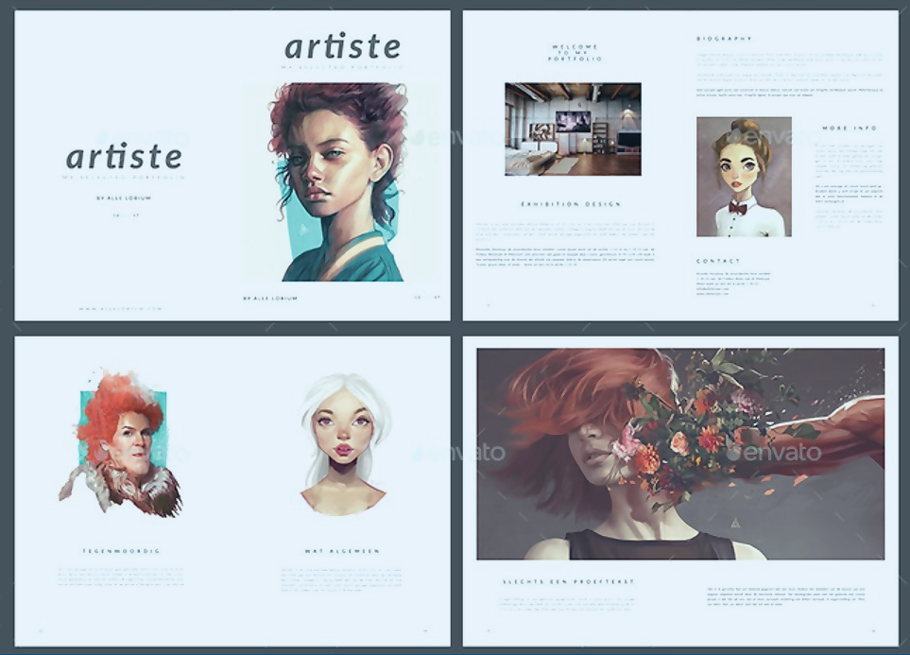
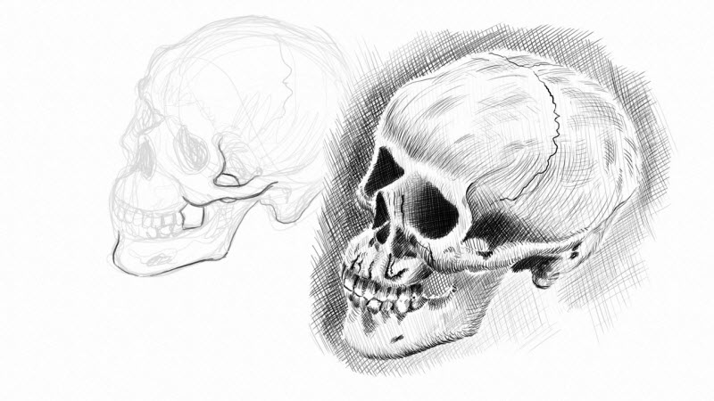
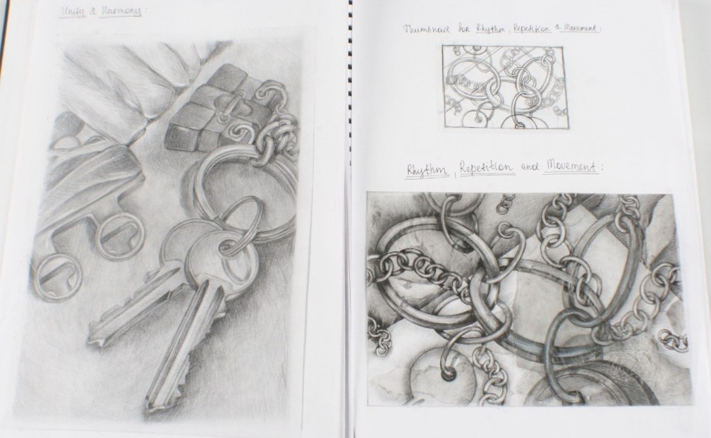
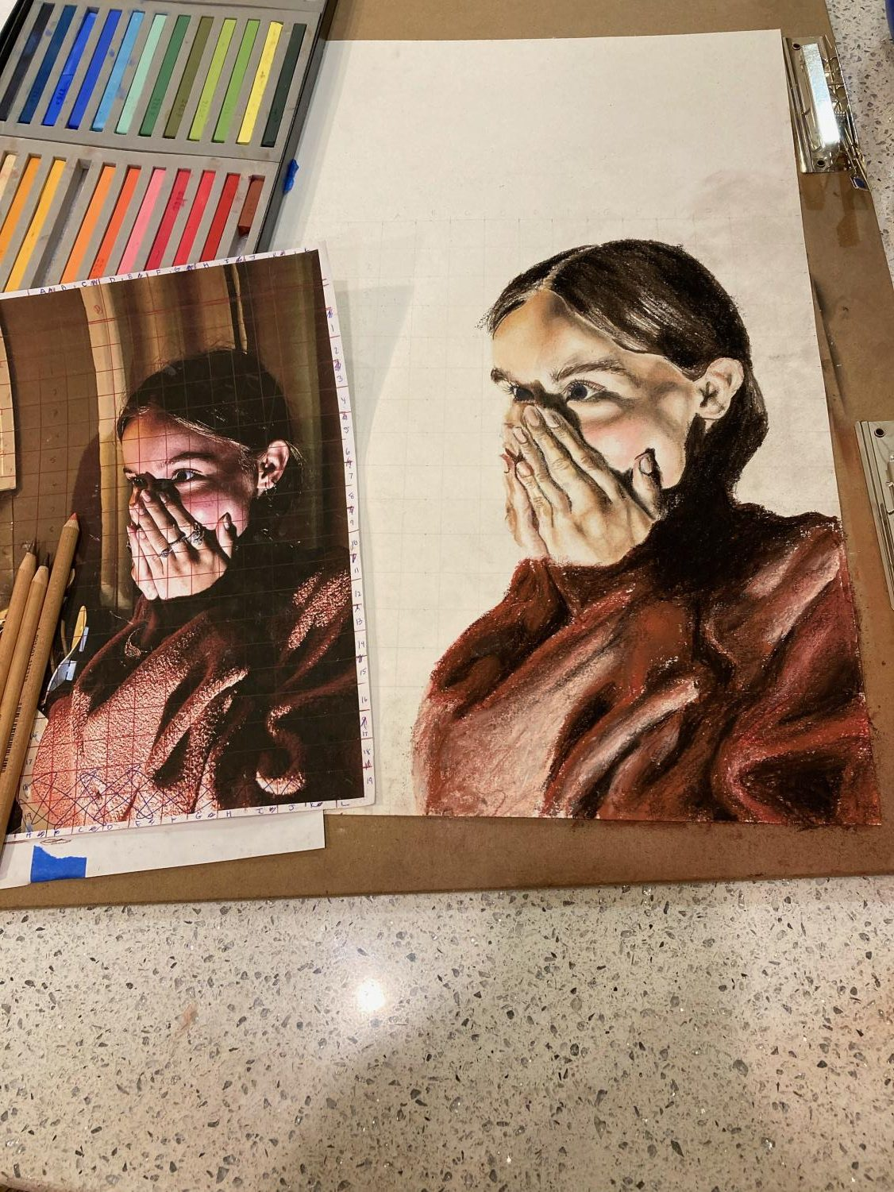
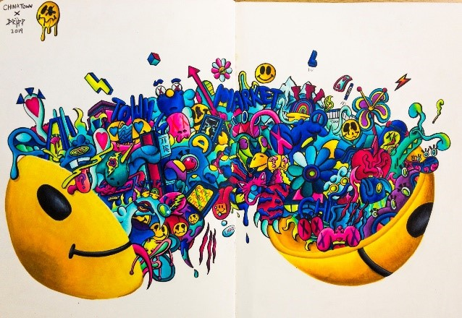
Portfolio samples

Slide 7
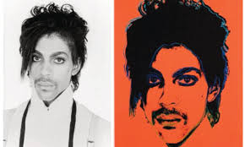
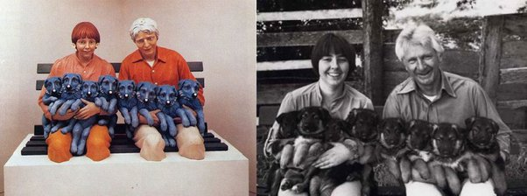
Copyright
Fan art
Appropriation
*Artwork for general audiences
Notes:
Items to be aware of: Copyright infringement is a direct take on someone else’s artwork with no alterations; like using Sponge Bob as your artwork. Portraits of actors, musician, or celebrities which were photographs or the reproductions of a work by another is also considered copyright.

Slide 8
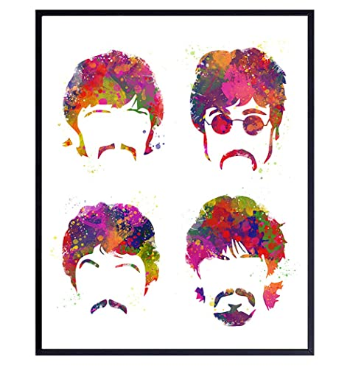
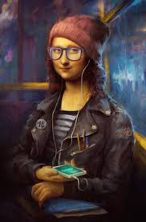
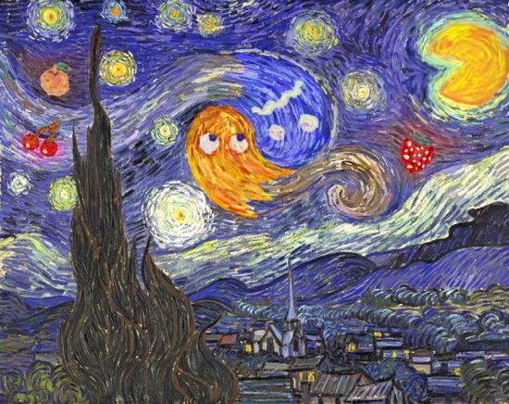
Copyright, fan art, appropriation
Notes:
Fan art recreate someone else’s work, from movies, television, etc. You may be inspired by these, but you need to give credit to these or they will be flagged for appropriation.
Appropriation is the safest of these. Basically, you are taking something that exists, altering it and creating something new. Gives new expression or new medium to the work to make it yours. Make sure you indicate this in your comment section of your portfolio. If you are unsure, always indicate the original sources– must give credit to the original artist.
Something to also consider as an artist is “Who is your audience?” Because Parker Arts Portfolio Day is a program presented by art department of a local government, who operates a public building where families with young children frequent, students should consider the content and title of their artwork to be appropriate for all ages to enjoy.

Slide 9
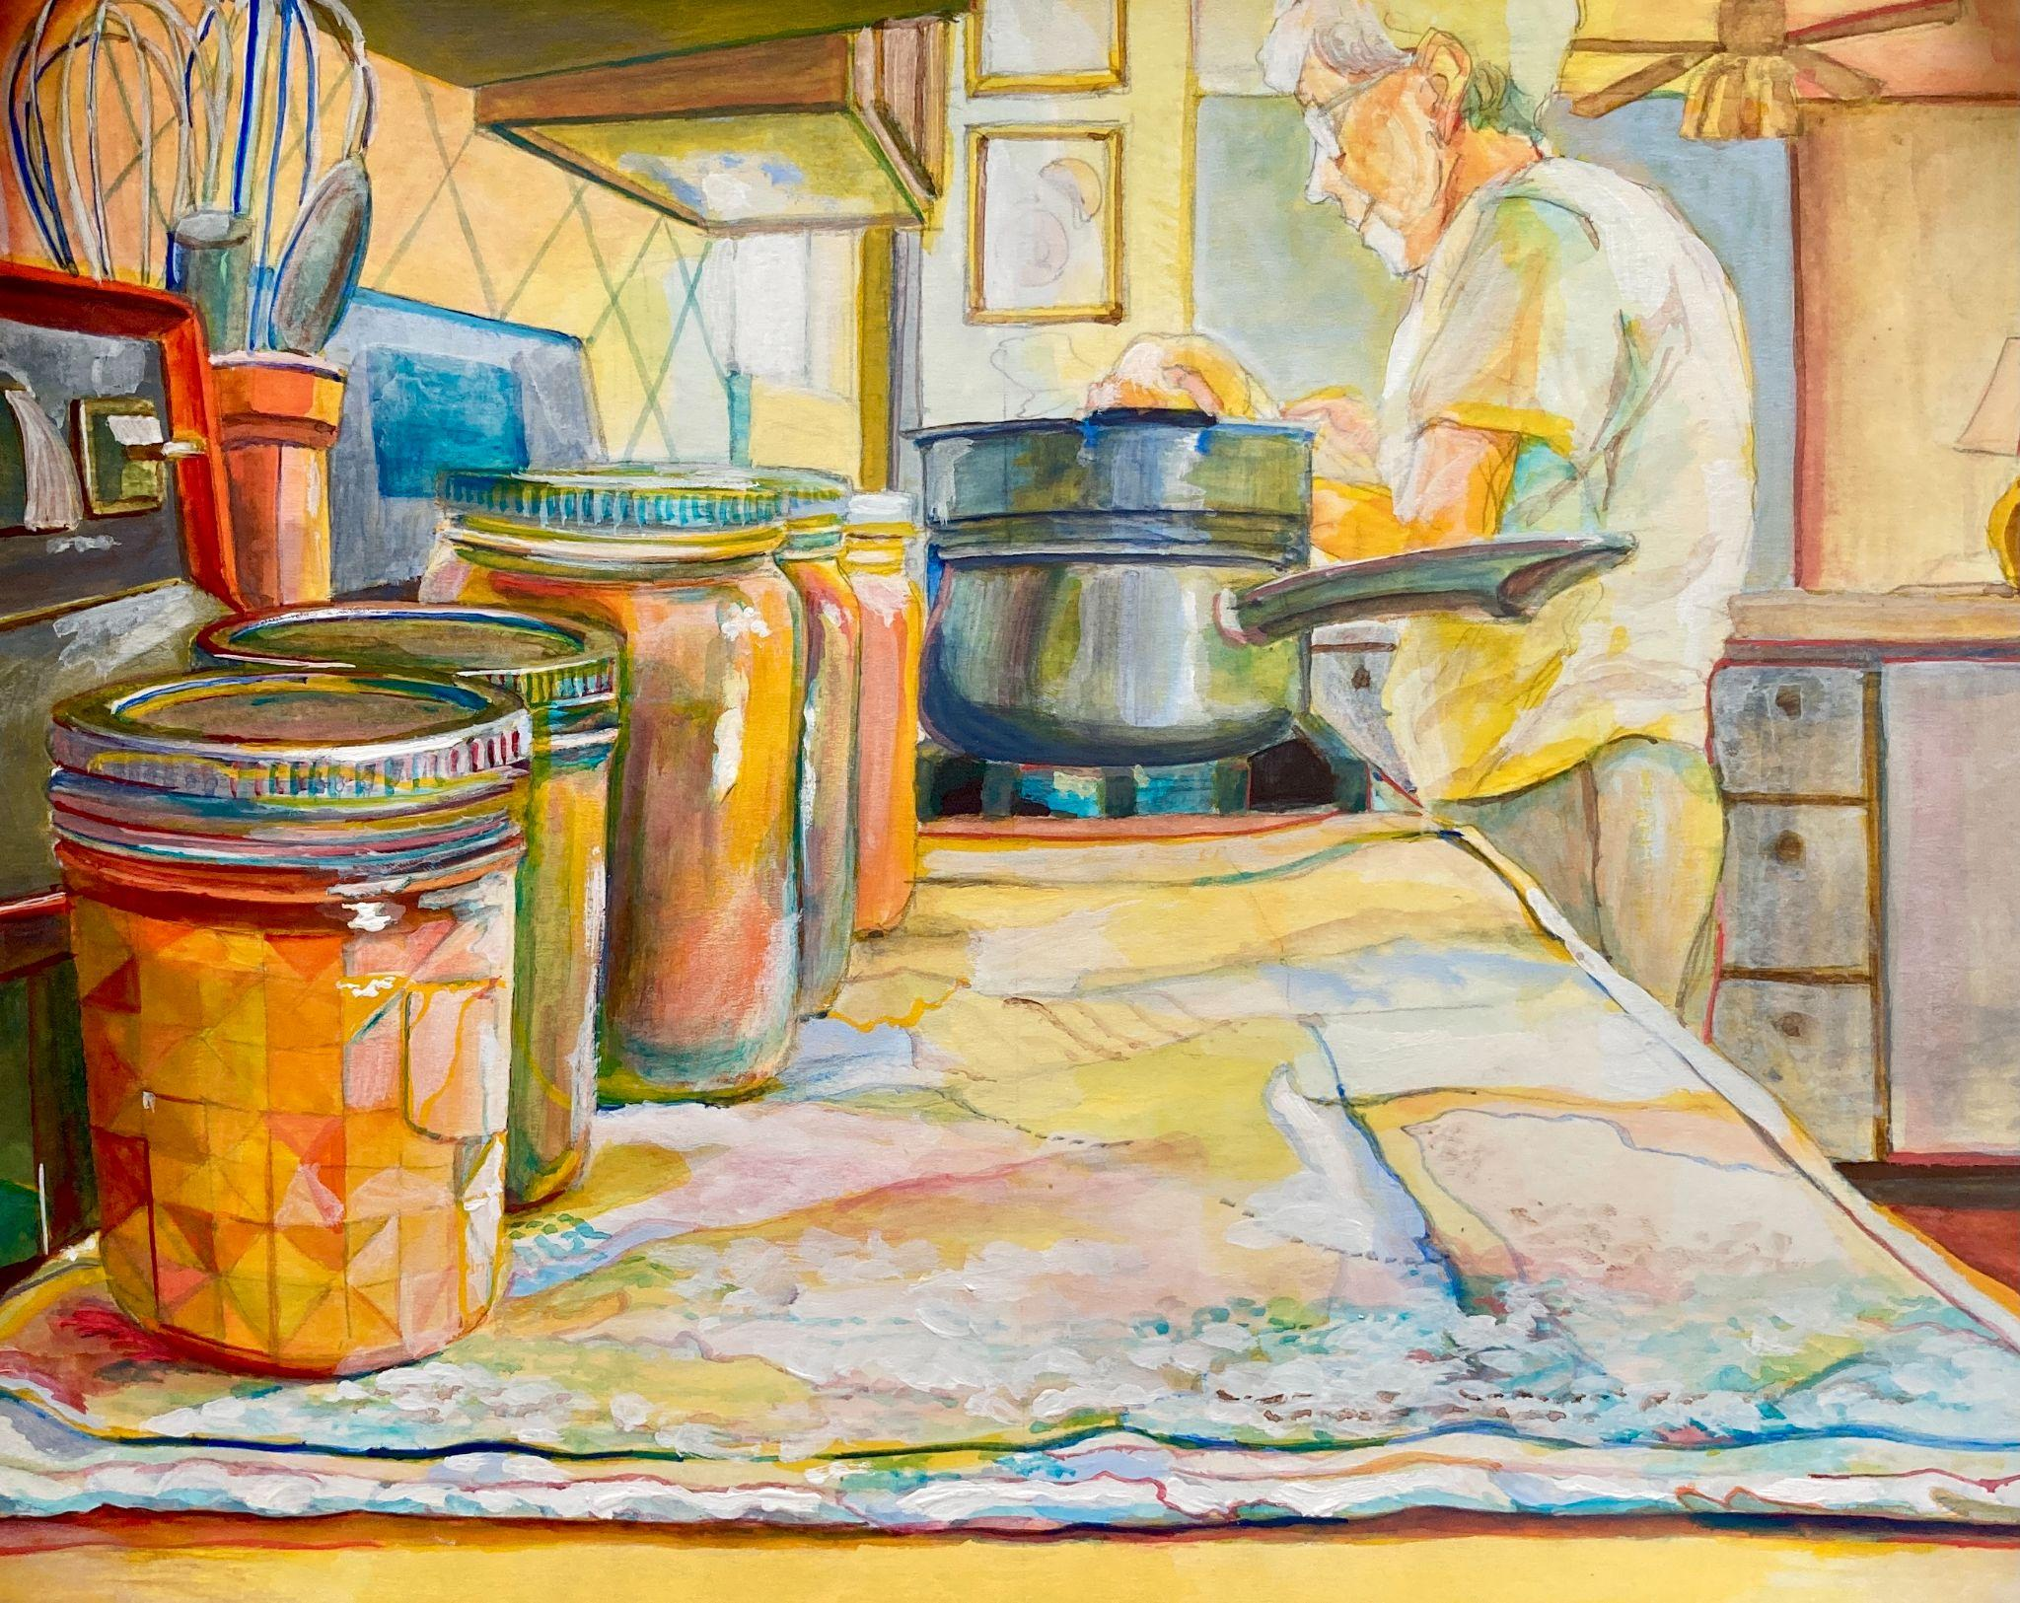
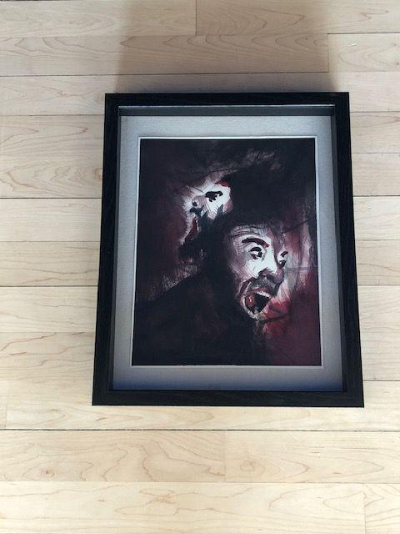
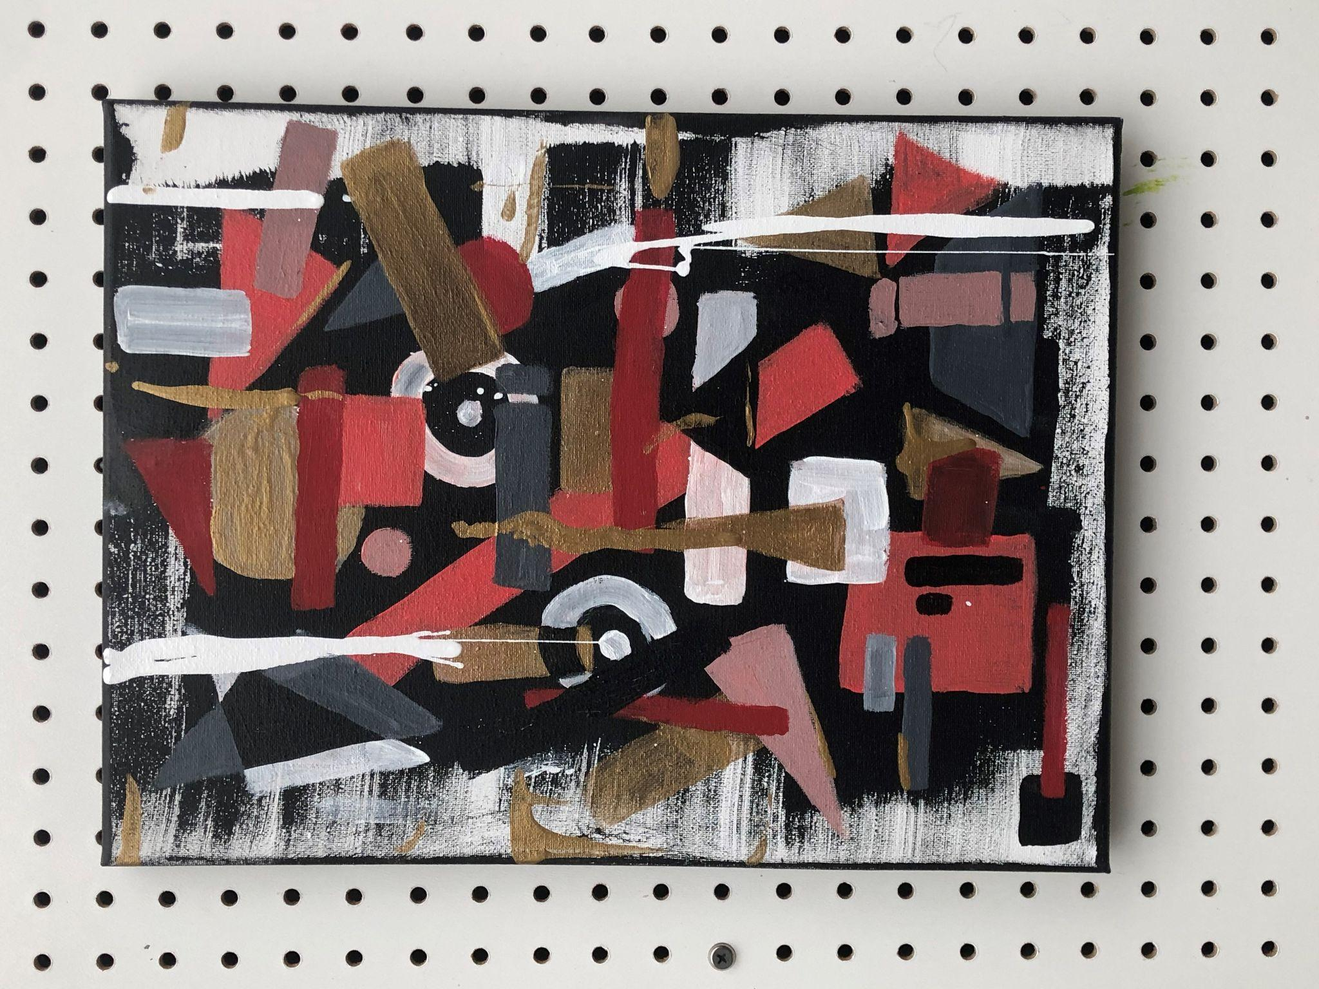
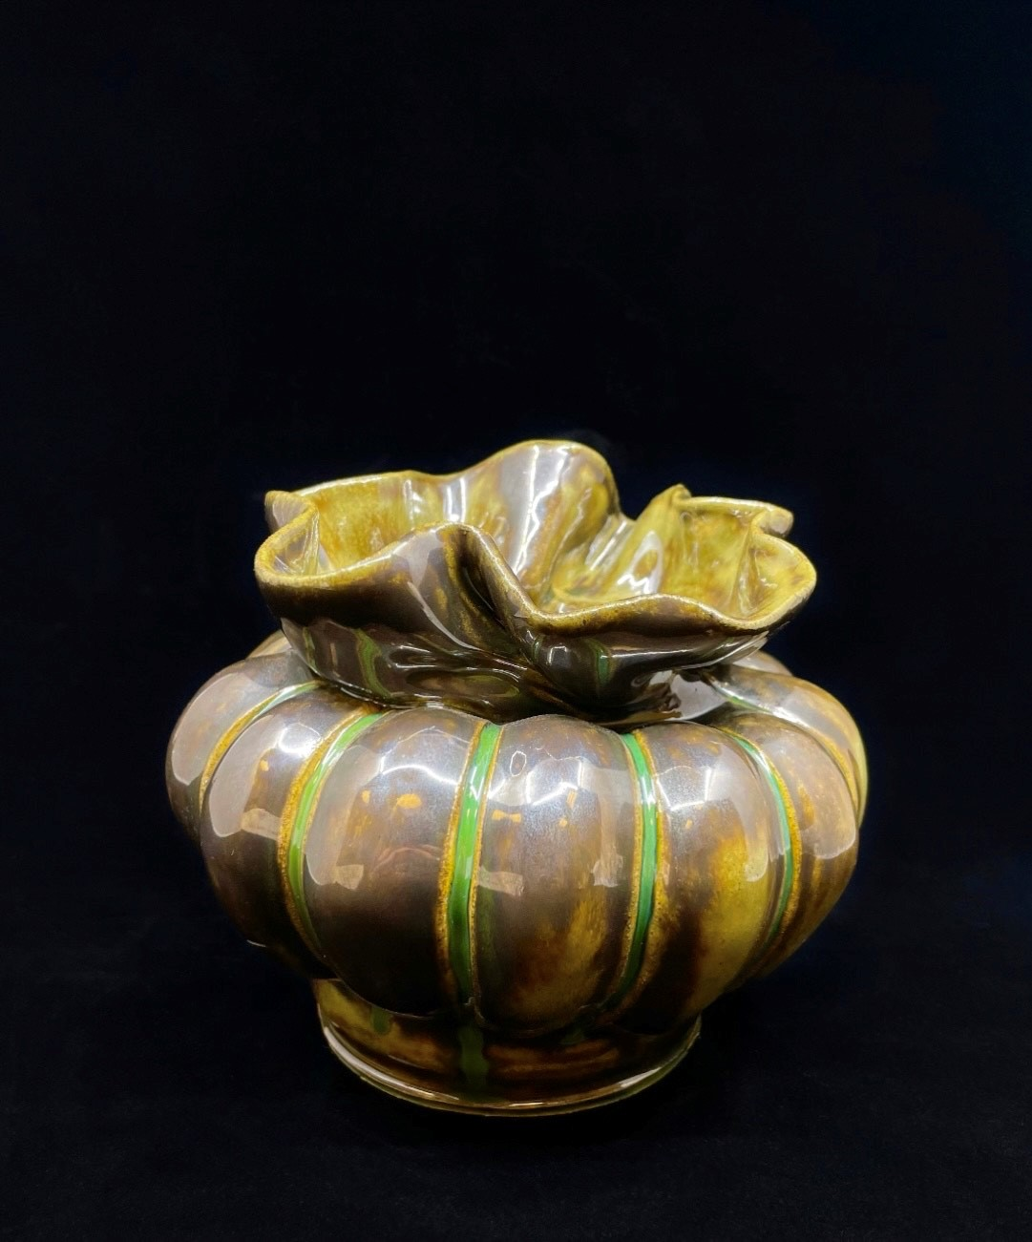
Good image
Not-so-good image
Taking images of artwork
Notes:
Quality images of your artwork can make or break your presentation. Consider lighting, framing of images, and backgrounds when taking a picture of your artwork for your portfolio.
Smart phones these days are as good as cameras. Check out apps such as “Lens” to help you take much better photos and edit images for the best presentation.
Find good lighting, scan the room with your camera to find the image with the softest light. Ambient light from windows is often excellent light, as long as you place your work so that you don’t have strong glare on the painting surface.
Once you find the ideal spot, place your art as flat as possible. It’s best if you can hang paintings on a wall or lay them on the floor and stand over them (try not to cast a shadow). Step back, frame in and focus. Turn on grid feature on phone, line up square. Do not prop art against the wall; this creates a parallax photo. Keep shooting until you have an accurate image. Consider adding fill light, which can be a white screen or paper that reflects light back onto your image. This will help fill in the shadows with white light.
For 3D work it is very important to remove the background. Hang a plain sheet or use a clean, white corner to make the background as simple as possible.

Slide 10
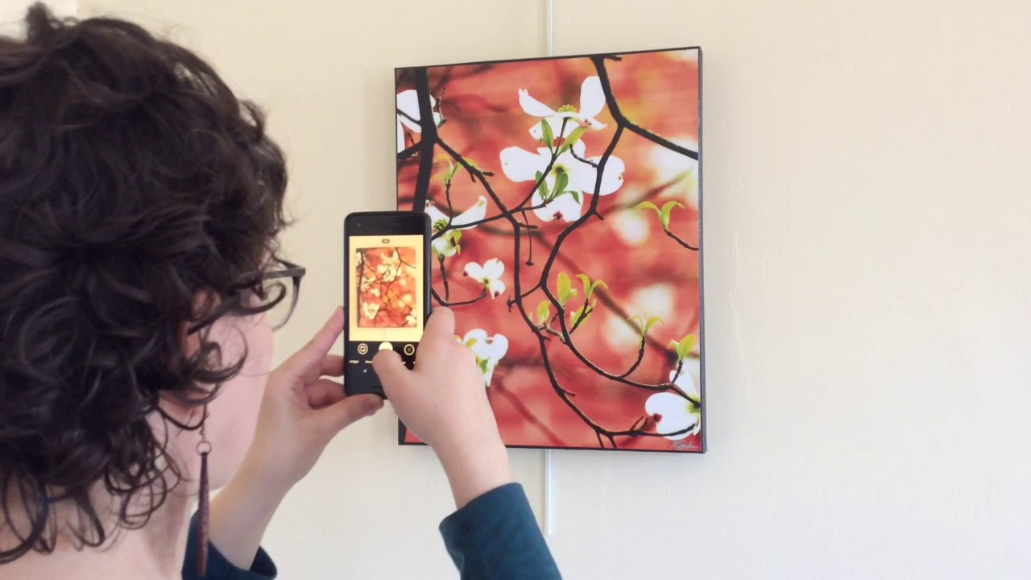
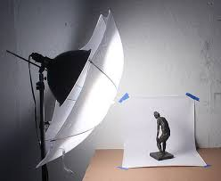
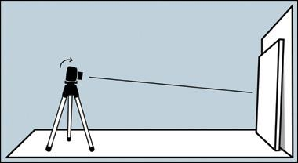
Camera or smartphone
Place art flat
Frame in and focus
Remove background distractions

Slide 11
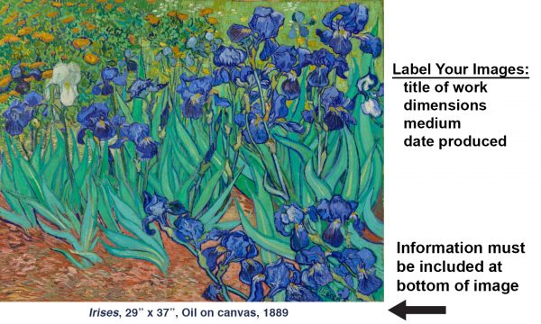
Upload your artwork
Best image of your artwork
JPEG, TIFFS
Under 5 MB
List credits on the slide:
Title
Medium
Size
Year
Additional notes
Notes:
Upload the cleanest, clearest, best image of your artwork. Make sure the file is a JPEG or TIFF, and a manageable file size under 5MB. On each slide, adjacent to your image, please include your artwork credits: title, medium, size and year it was produced. You may also include additional notes – this is where you would give credit for appropriated work, etc.

Slide 12
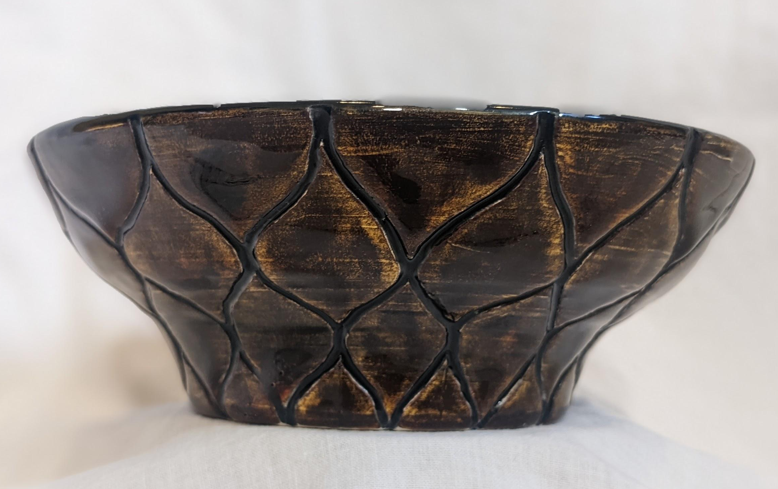
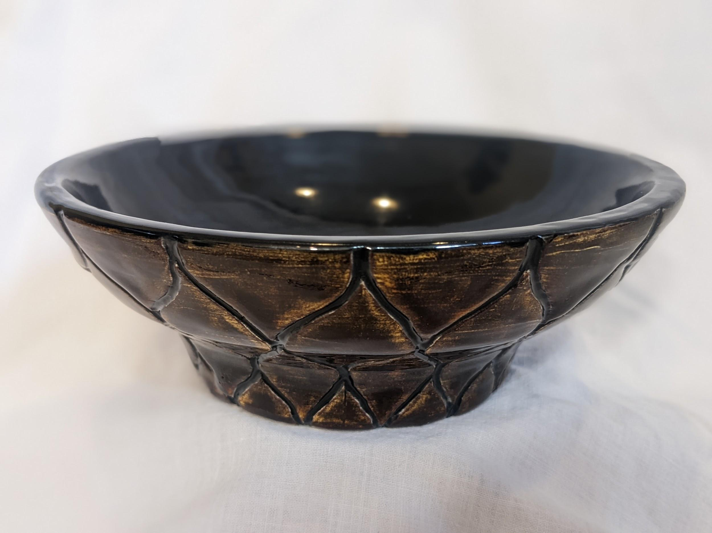
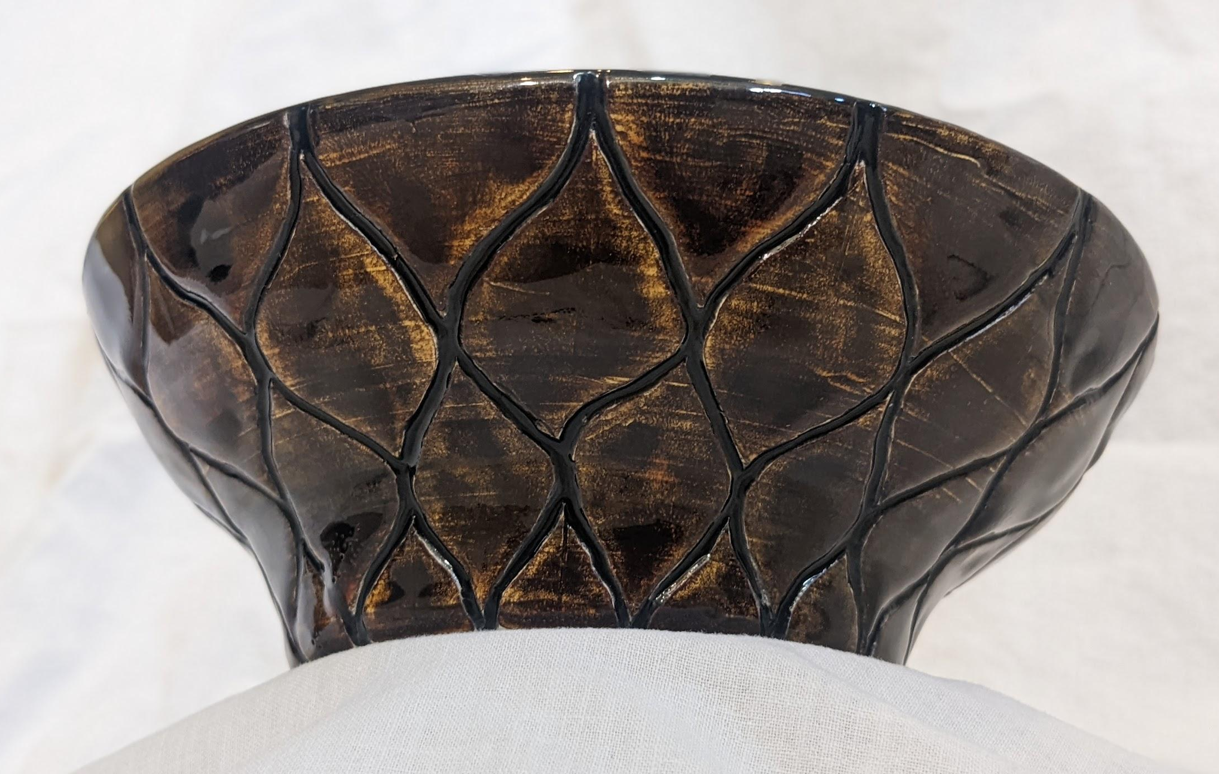
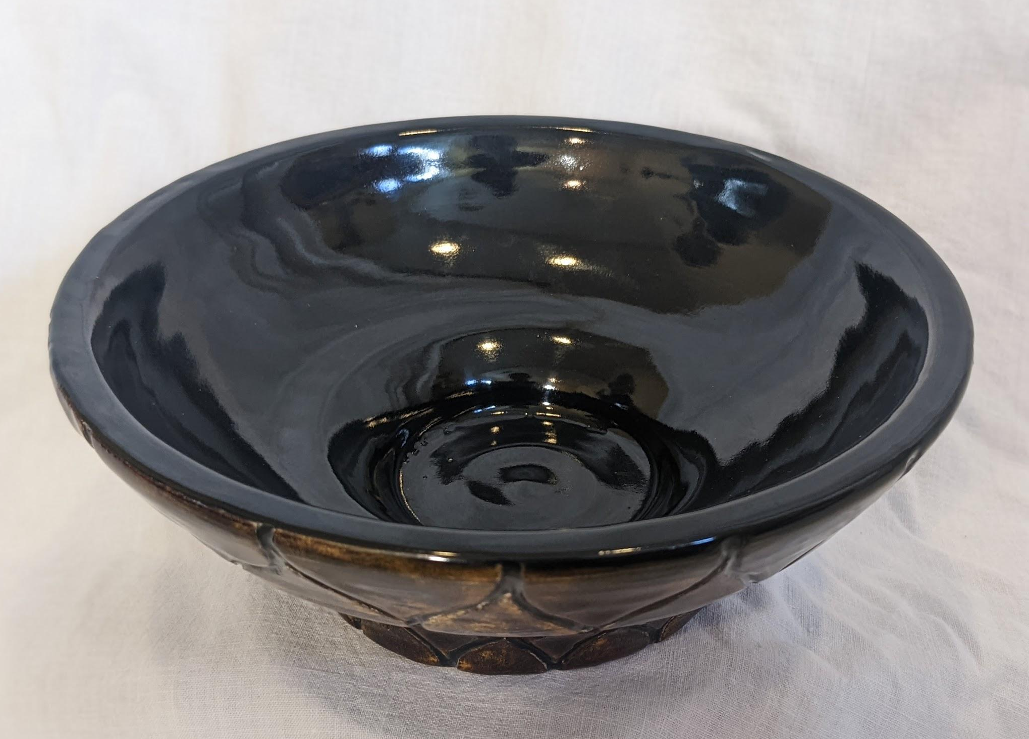
Ceramic Bowl
Glaze on Clay
6.5 x 2 in.
2019
Notes:
Here is a good example of a 3D slide. Notice it includes various views of the 3D work, the title, medium, size and year it was produced.

Slide 13
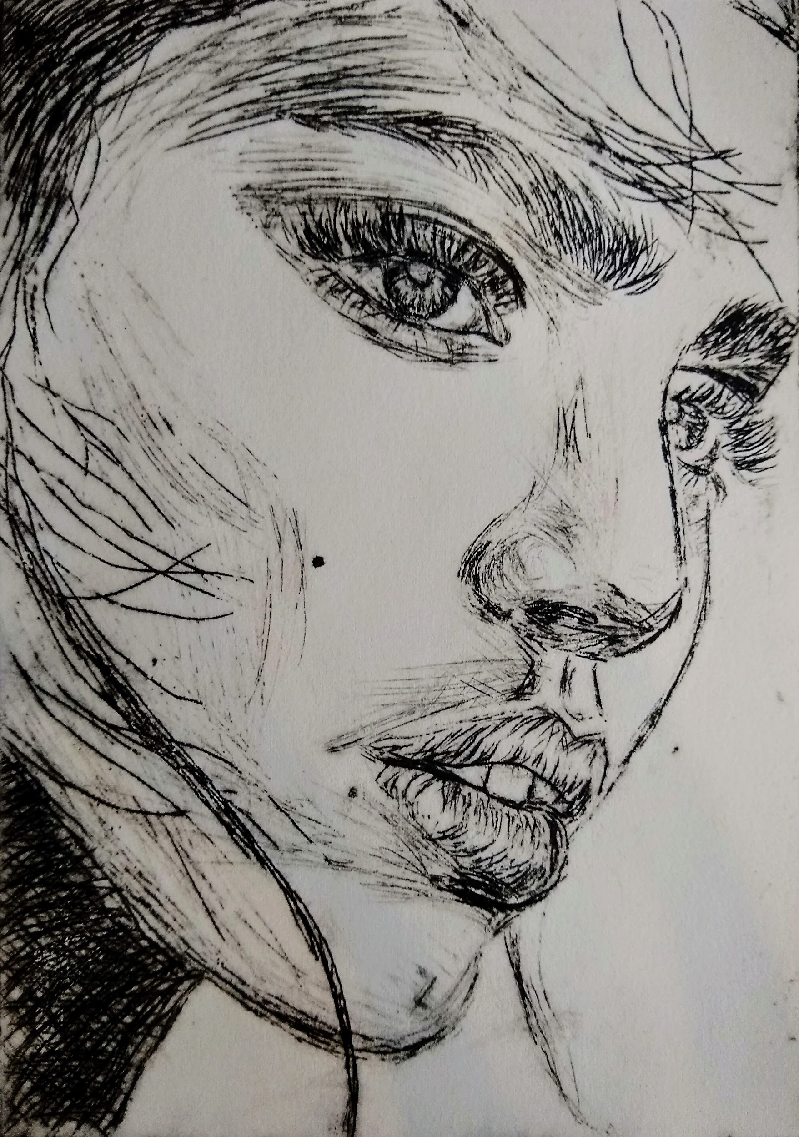
Longing
Acrylic on Paper
5 x 7 in.
2021
Notes:
This is another good example of a good slide in a portfolio. The image of just the artwork, title, medium, and year it was produced. There are no additional notes listed, but this is where you would add notes such as credit for your appropriated work or your purpose in the artwork.

Slide 14
Artist statement
SAMPLE
I [action word--create, paint, photograph, etc.] through/with [method/means/what you do] because I’m passionate about [your Why] and [core values]. My purpose is to [your Why] for [target audience] who want [thing they are seeking from art, whether they know it or not]. My brand, which is [specific aspect of your art that sets you apart], is built on the foundation of [core values].
Up to three paragraphs that include:
Why
Core Values
Mission
Notes:
An artist statement is an important piece of any artists’ work.
Often “artist bio” and “artist statement” are used interchangeably. The difference between these two things is minimal. The bio is focused more on you and your career, and the artist statement is about you but tailored toward a specific project or exhibition or in this case your portfolio.
Talking and writing about yourself is hard and, at times, painful. It sounds like bragging. Or you don’t think you have anything special to brag about. Don’t worry, it’s not bragging—people really want to know about you and what makes you - you.
Here is a sample of an artist statement:
I write and interview artists because I’m passionate about telling their stories and creating a better understanding of the artistic process. My purpose is to help non-artists learn how creativity happens so that they can grow and embrace the arts with a deeper appreciation. My brand, which is The Incurable Optimist, is built on the foundation of empathy and vulnerability as the true path to pure artistry.
For help, refer back to this slide and fill in the blanks.

Slide 15
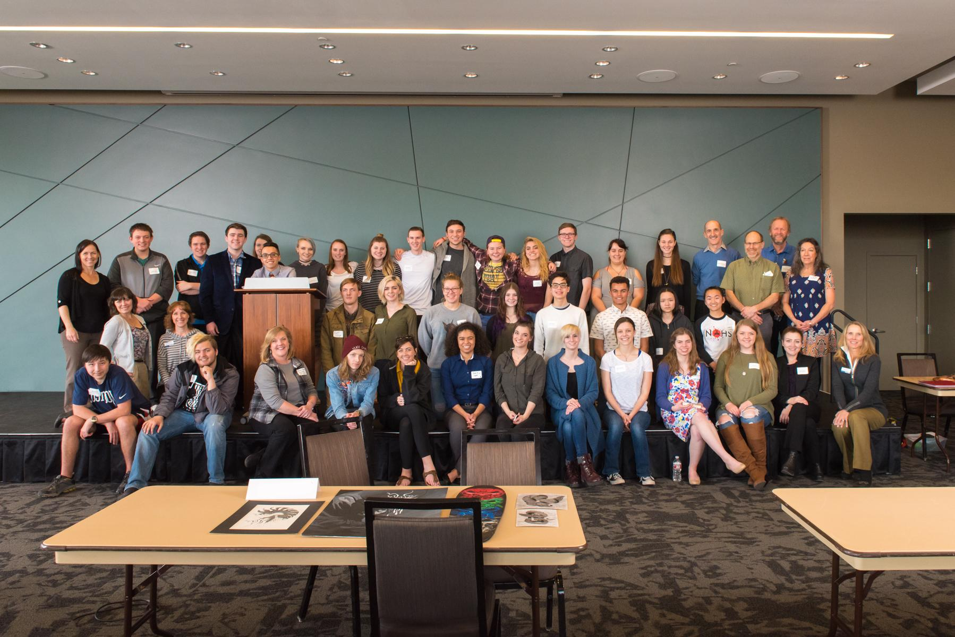
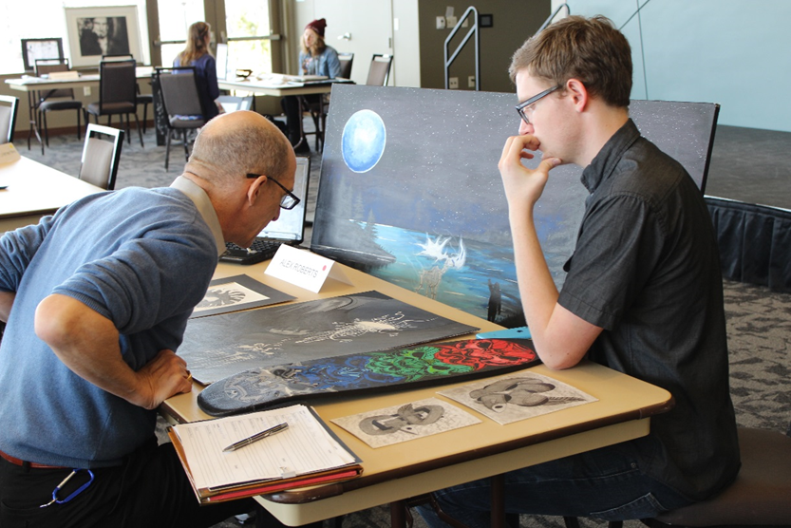
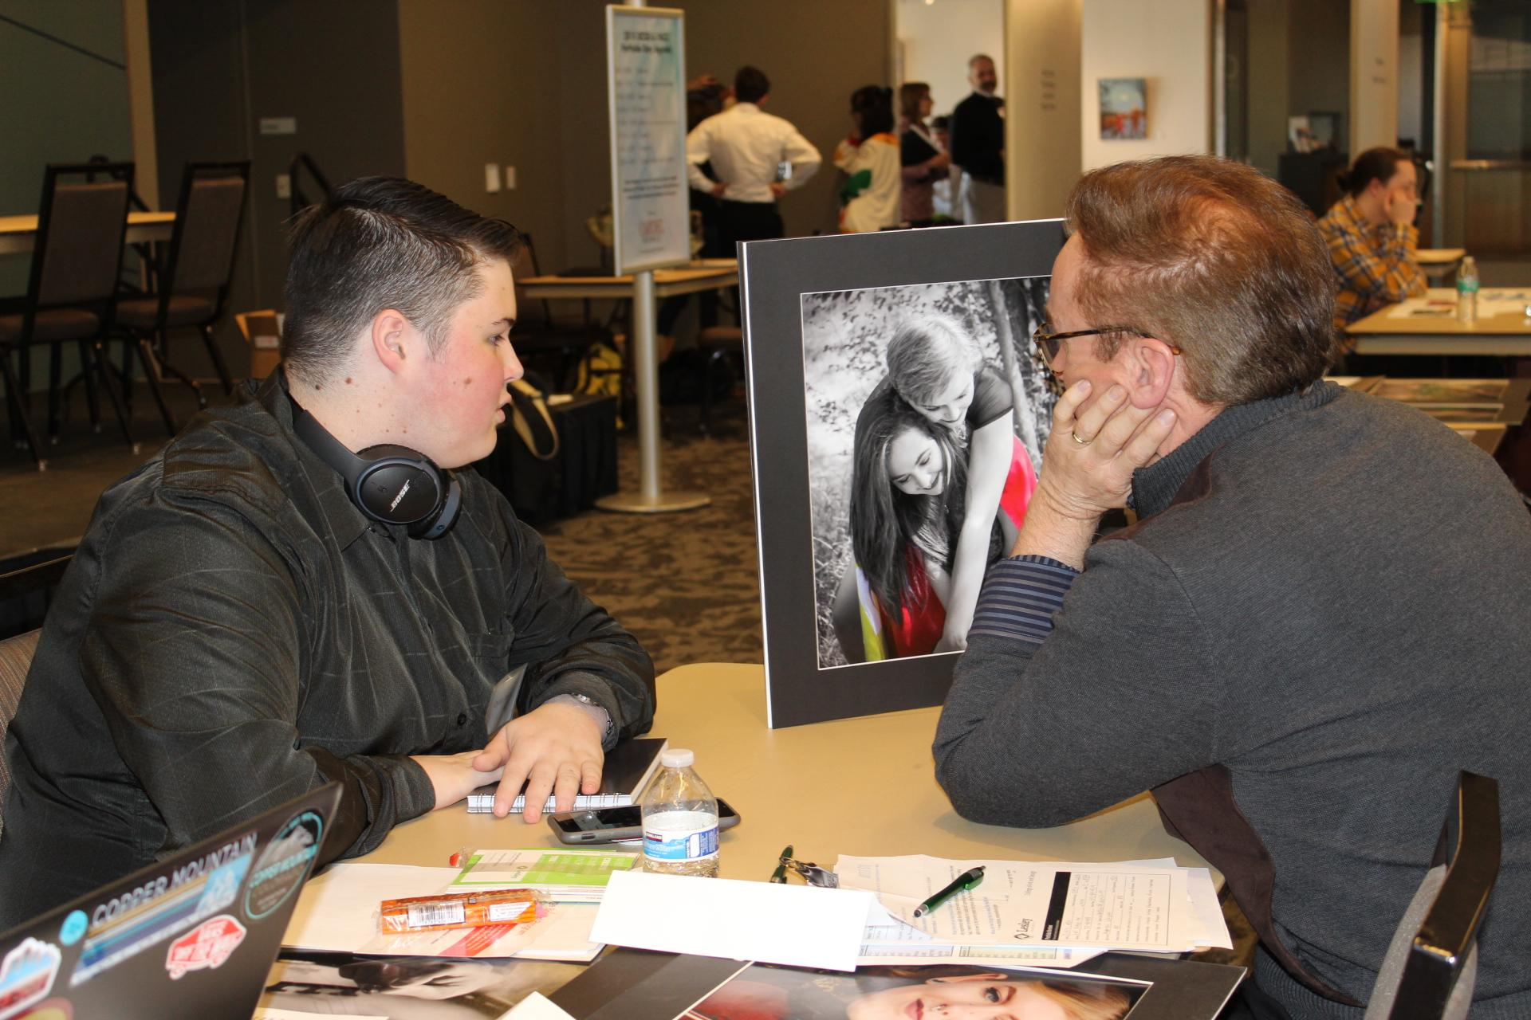
Portfolio day is here
Portfolio Day Schedule
8:30-9:00 AM Check-in
9:00-9:10 AM Opening Remarks
9:15-10:55 AM Portfolio Reviews
10:55-11:00 AM Break
11:00-11:45 AM Lunch & Panel Discussion
11:45-12:00 PM Closing Remarks & Bright Futures Instructions
12:00 PM Check-out
Arrive at the PACE Center at 8:30am to check in
Be prepared to log into your Google Slides Portfolio
You are encouraged to bring in an actual piece of artwork, especially 3D artists
Dress to impress
Be ready to engage
Notes:
Once your slides are built with images, credits and your artist statement you are ready! Portfolio Day is scheduled during a school-day. You will have to seek permission from your parents and your teachers to miss school. Please be aware of that now so that you are not dropping out as the event nears. A waiver will be sent to your teachers/parents for their approval for your participation. Equally, there is a $10 fee to participate. Please work with your teachers to pay the fee.
You will be grouped with about five other students with similar art medium. You should be prepared to show your portfolio using Google Slides. Each review room will have a laptop for you to log in to your Google Slides account. You will have approximately 20 minutes present your work to two professional artists or art professors and your peers and received a critique and discuss feedback. We strongly suggest that you write 3-5 sentences about each of your pieces so that you are ready to talk about the artwork.
You are encouraged to bring an actual piece of work that represents your talents. It does not have to be gallery ready at that time.
Dress to impress and be ready to share about you, your passions, your methods, and join in on other peer review conversations.

Slide 16
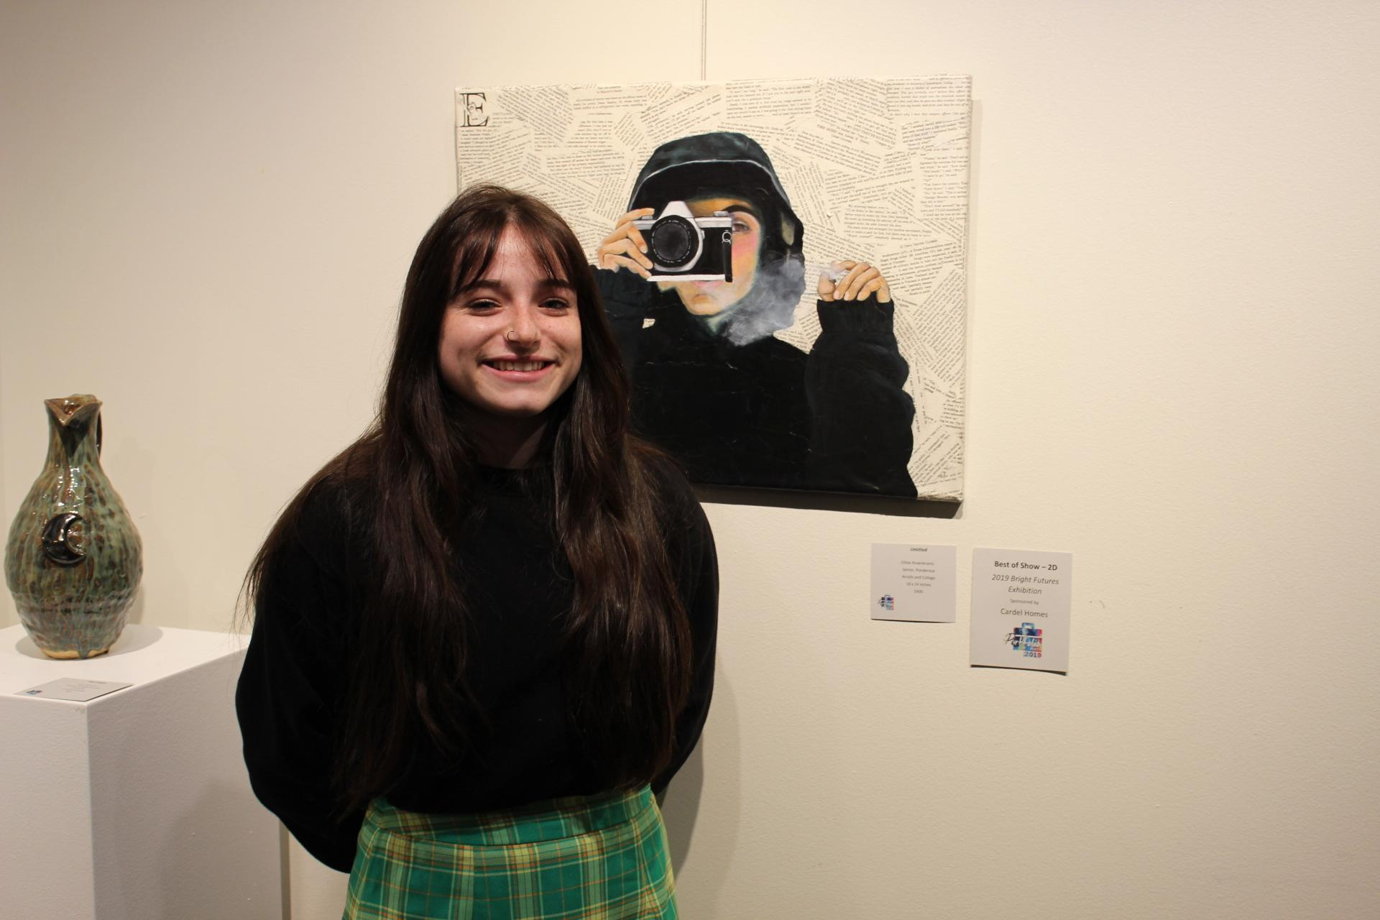
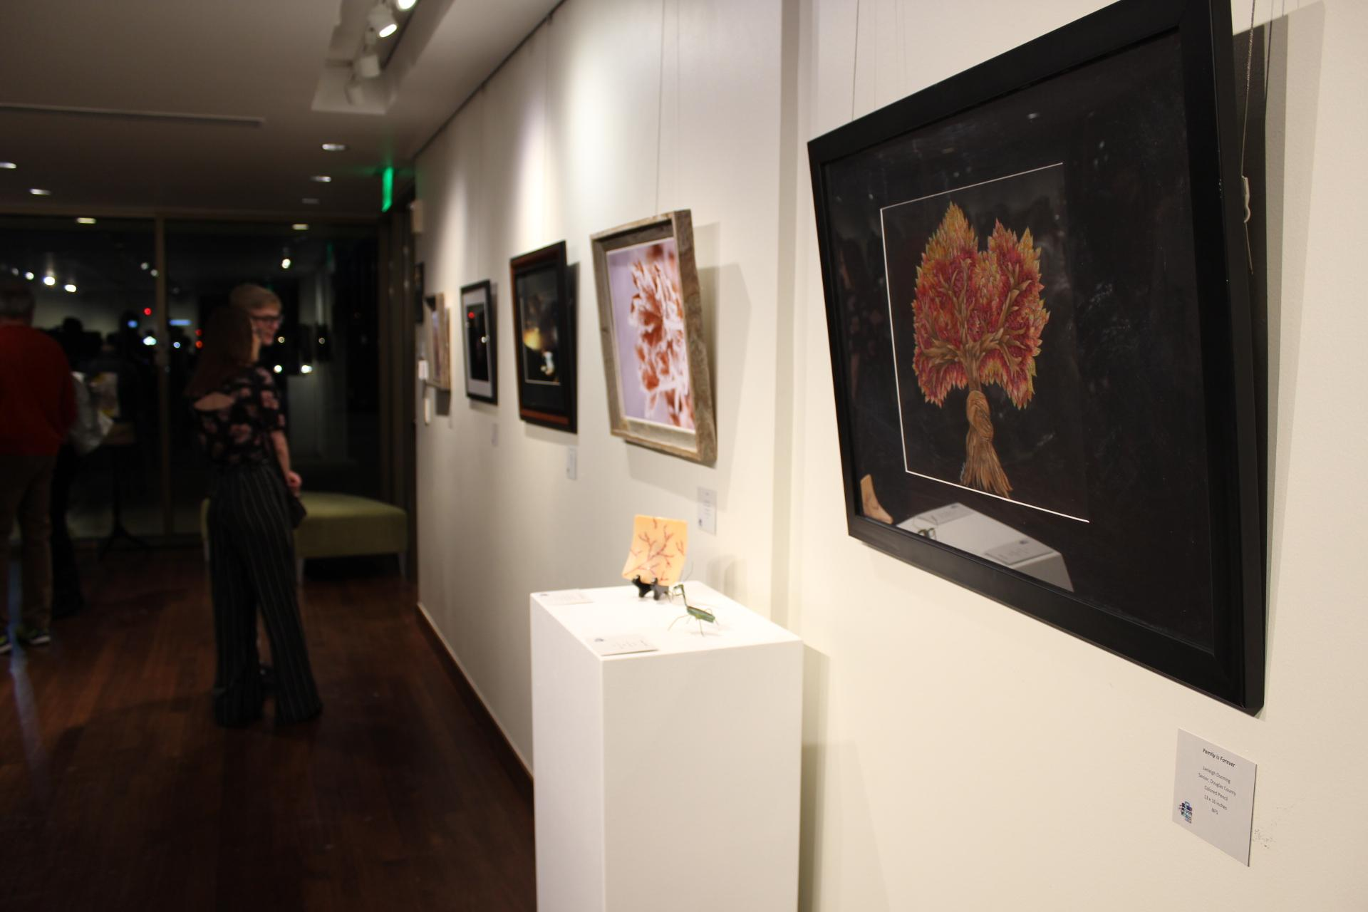
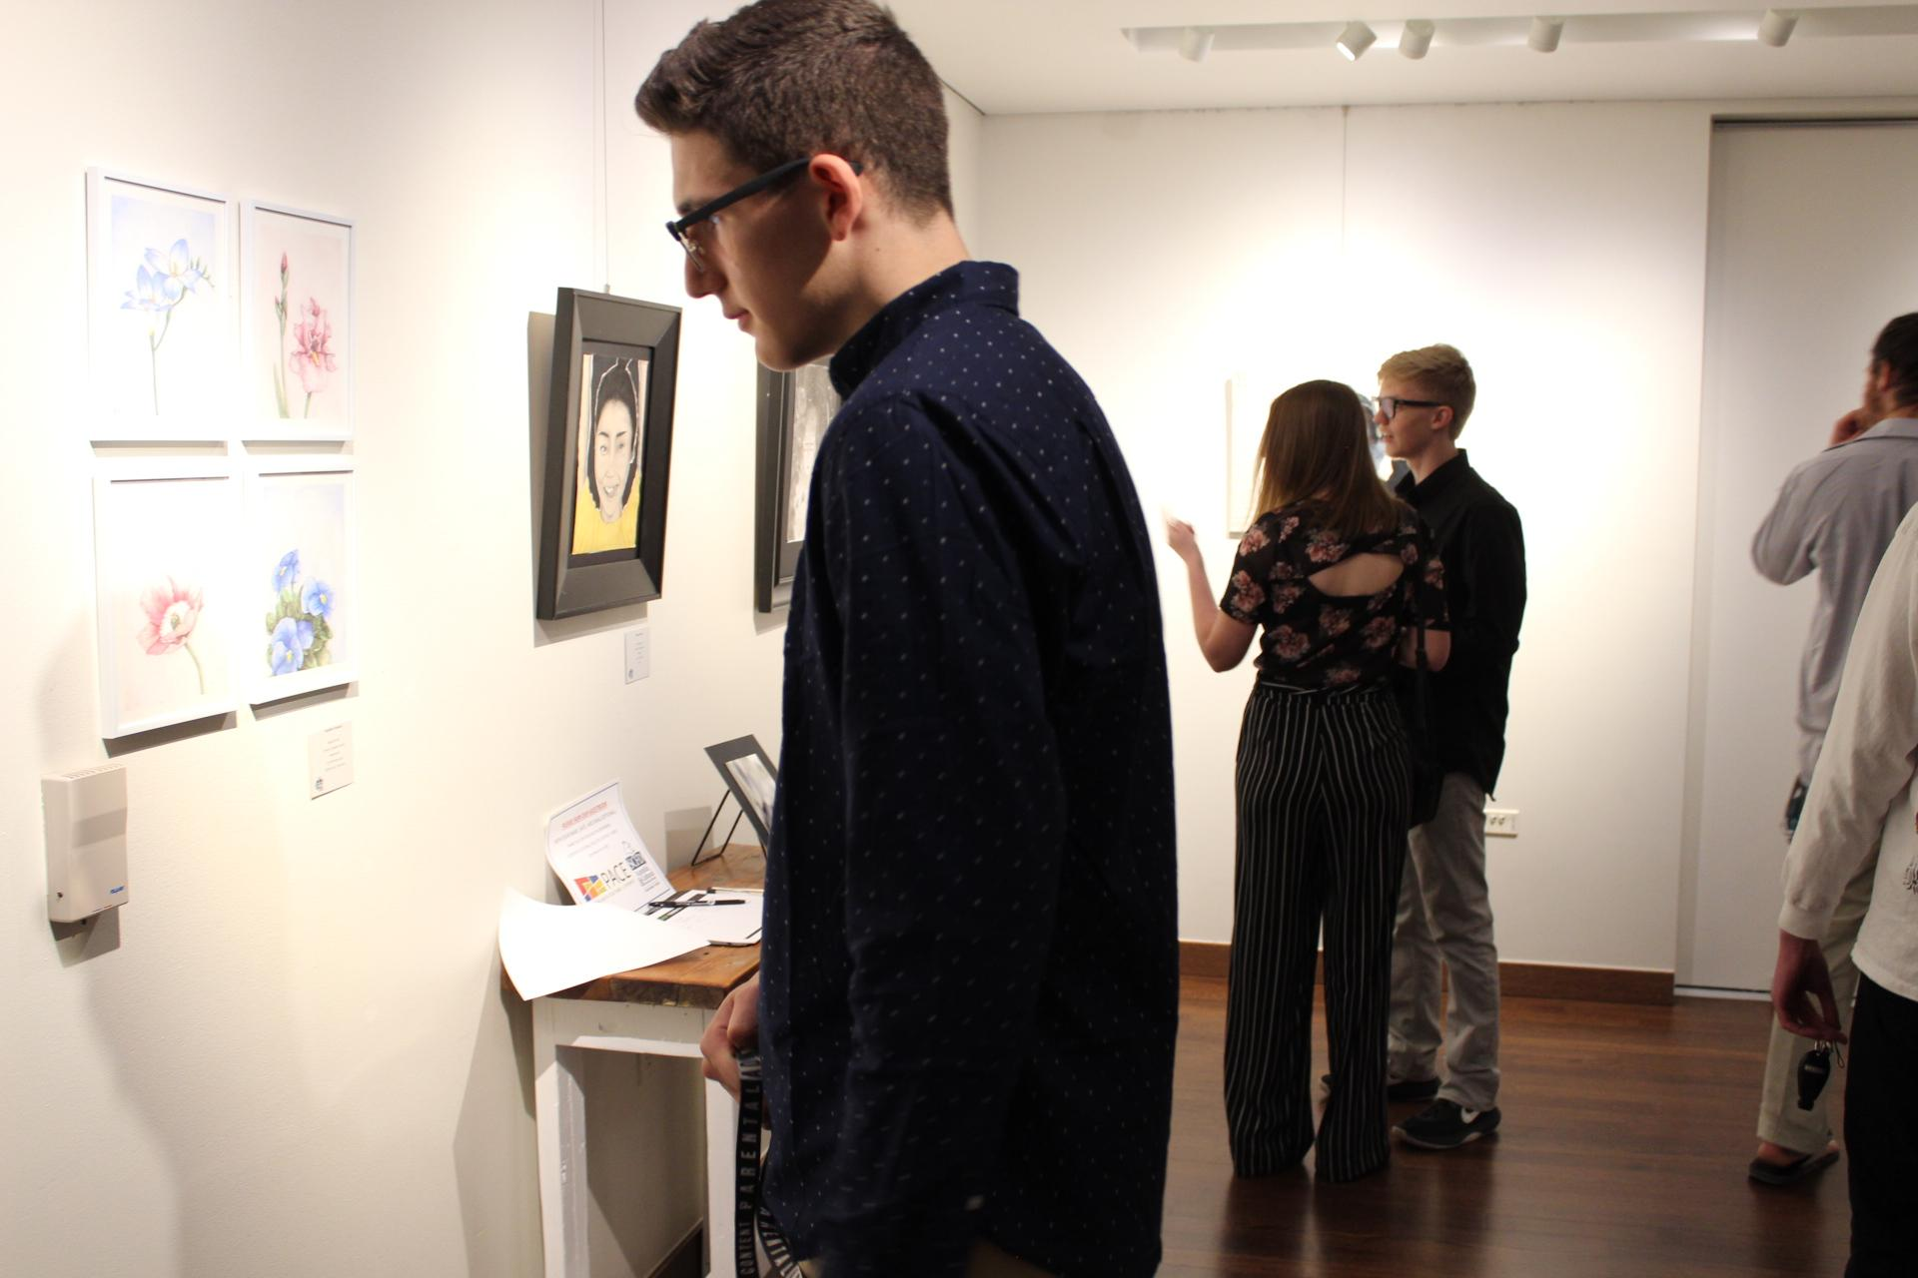
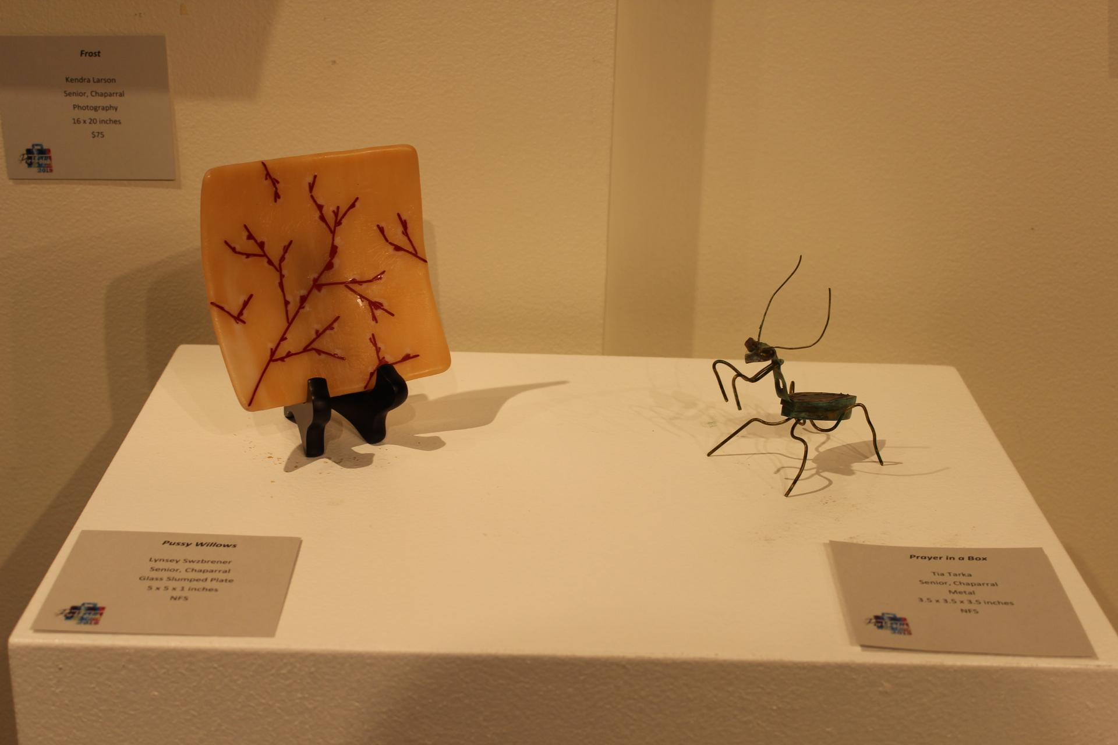
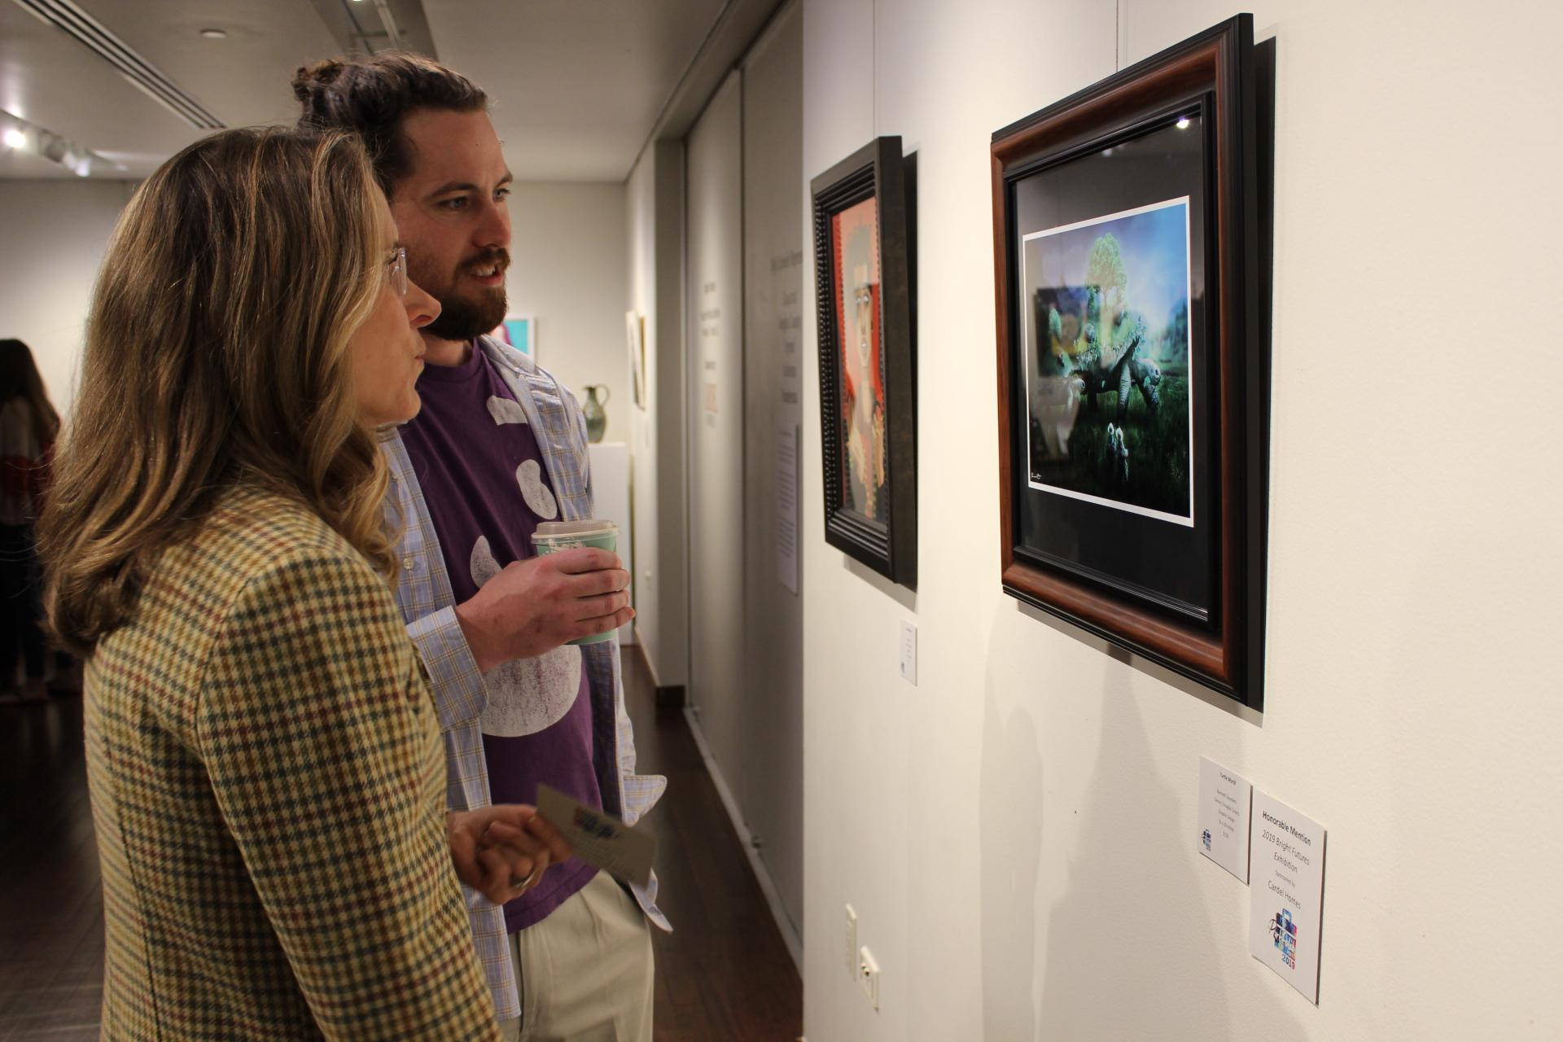
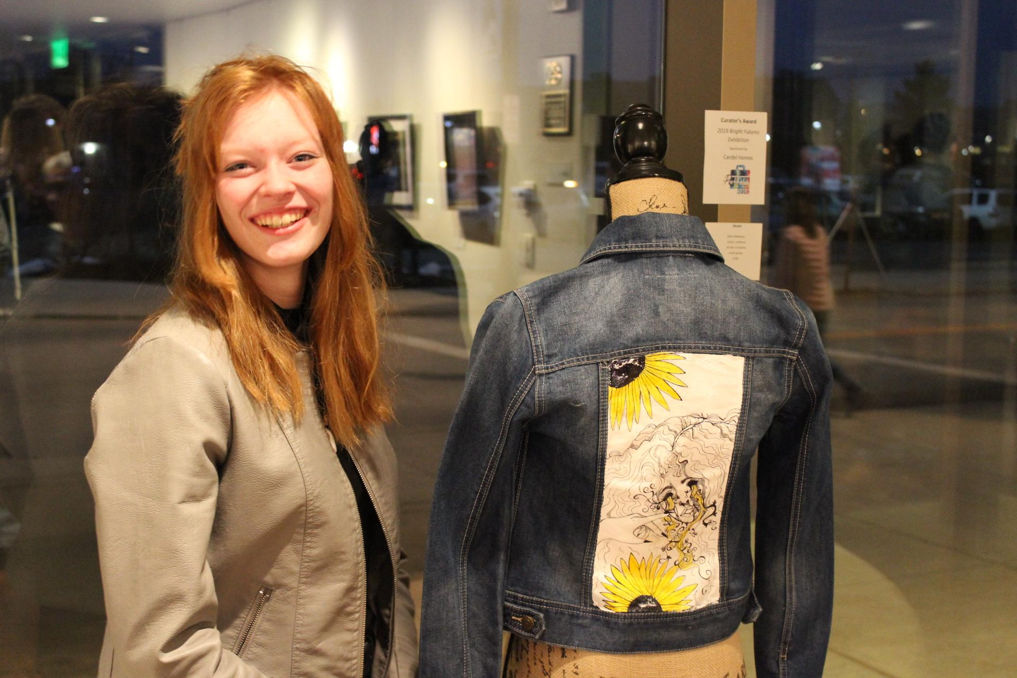
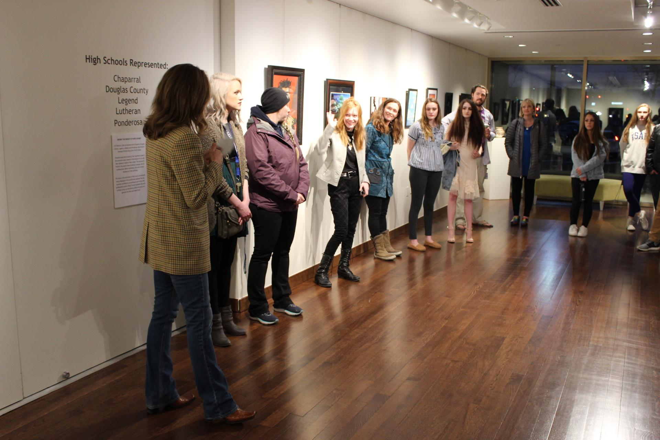
Bright futures student exhibit
Notes:
During the review process, your reviewers will suggest one piece of artwork that you should provide as part of the Bright Futures student exhibit at the PACE Center. You will have one week to prepare the artwork to be gallery ready, which means, properly framed and labeled.
Framing does not need to be expensive. You can get a frame from your teacher or purchase one from Michaels of Hobby Lobby. The frame must have glass/plastic and have a wire hanger attached to two D-rings on the back of the frame. 3D work will be placed on pedestals.
The label of your artwork should include: your name, title of artwork, medium, size, year completed, and price if it is for sale. If it is not for sale, you should label it as such (NFS). You can find these labels online, where you can type and print, and attach to your artwork. If your artwork sells, Parker Arts will send you a check for the full amount of your artwork. Because of this, Parker Arts must receive a completed W9 from you. You can ask your parents to assist you with completing this form.
Refer to Portfolio Day online to see details for the exhibition dates, including artwork drop off and pick up, and the exhibit reception for family and friends to celebrate your work displayed in a professional gallery.

Slide 17
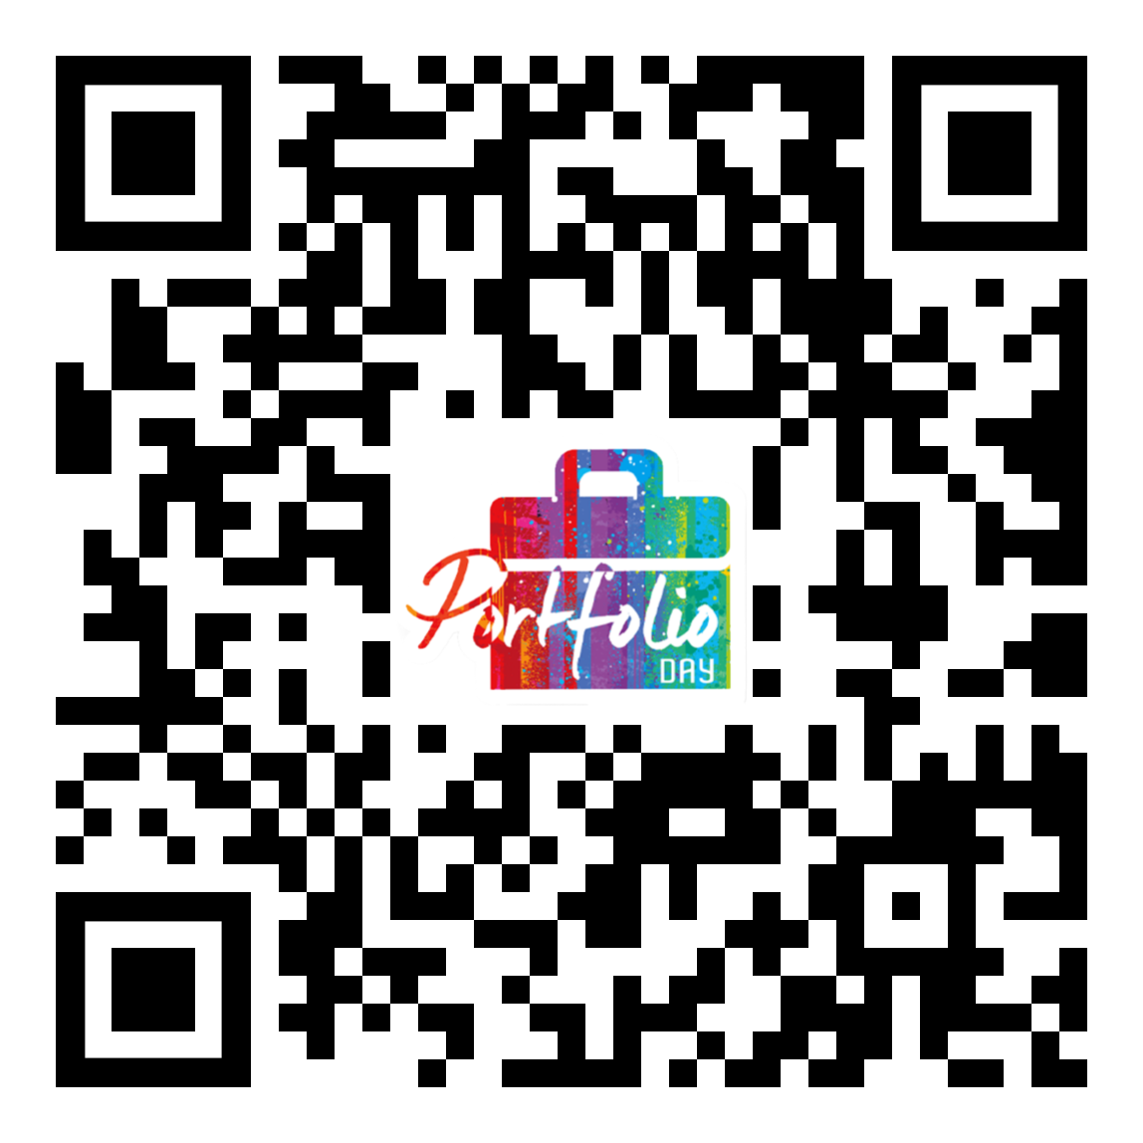
Portfolio Day
& Bright Futures Exhibit
PACEedu@parkeronline.org
Notes:
You can go directly to the website for these forms and details by scanning the QR code here. Please send any questions to PACEedu@parkeronline.org or talk directly to your teacher.

Slide 18
Thank you.
See you at portfolio day!
Parker Arts PACE Center 20000 Pikes Peak Ave., Parker
Notes:
Thank you very much for your commitment to Portfolio Day - we can’t wait to see you!

